Slide 1
Plan of action
SDLC exam
C++ exam – Fri July 5th 2019
Arduino – enrichment

Slide 2
objects
classes

Slide 3
Class / object
Some definitions
A class is a template
Written in c++ (or python, php, ruby etc)
The object is an instantiation of that class
Many objects instantiated of the same class

Slide 4
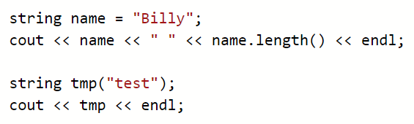

Classes we’ve already seen and used
Constructor
Method
String

Slide 5
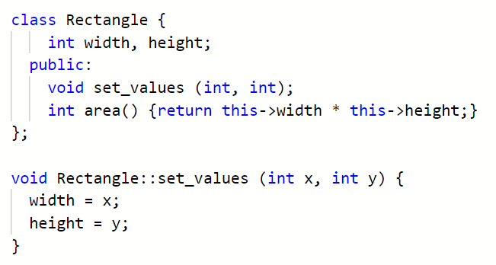
Object declaration

Slide 6
Private by default
Method /
Internal function

Slide 7
Prototype
Definition
Inline
Compiler optimization
The operator of scope (::) is used to specify that the function
being defined is a member of the class Rectangle and not a regular
non-member function

Slide 8
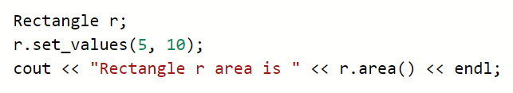


Slide 9
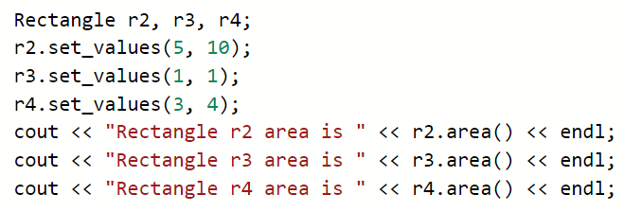
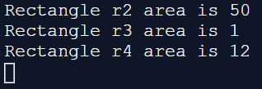

Slide 10
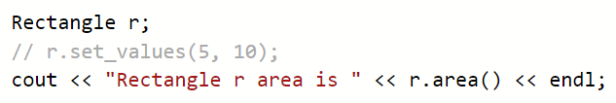
It’s possible to create a Rectangle and then call area without setting the dimensions

Slide 11

It’s possible to create a Rectangle and then call area without setting the dimensions

Slide 12
constructor
Special function / method call the constructor
Automatically called when a new class is created
Used to initialize the member variables, set up object, call DB, allocate storage, etc
NO RETURN TYPE not even void

Slide 13
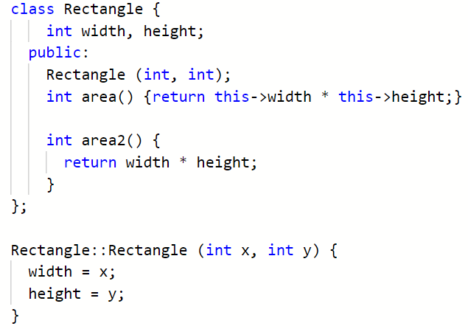


Slide 14
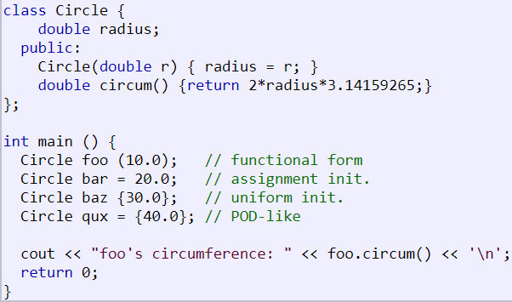

Slide 15
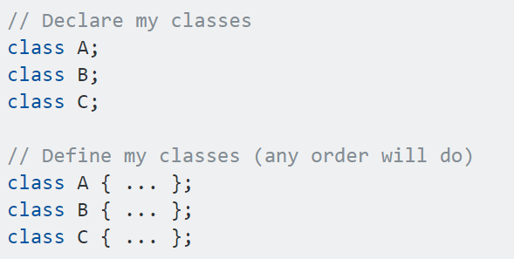
You can declare all your classes and then define them in any order

Slide 16
Today
Work your way through 5.2 stack
http://www.cplusplus.com/doc/tutorial/classes/
Create the following classes: Person (name, age, gender, pet), Dog (name, age, breed)
Create some people and give them pets
Dump / Display / Output everything
Create a pointer to an object
Investigate inheritance, add other pets into the system – cats, rabbits, snakes etc

Slide 17
also
Investigate object operators:
* & . -> []
Constructors and member initialization
Static members
Const members
http://www.cplusplus.com/doc/tutorial/templates/

Slide 18
May 6th bank holiday
Investigate object operators:
* & . -> []
Constructors and member initialization
Static members
Const members
http://www.cplusplus.com/doc/tutorial/templates/

